Slide 1

RAG FUSION with Cohere & WEAVIATE
Csaba Toth
ThruThink Support Chat Agent

Slide 2

Csaba Toth
Full stack engineer at startups
Director of Product Engineering at SportsBoard
CTO at ThruThink
Interested in AR/XR, AI/ML, lately Gen AI, LLM, RAG
GDG (Google Developer Group) Fresno lead, WTM (Women Techmakers) Fresno ambassador, tech meetup junkie

Slide 3

THRUTHINK
ThruThink® is a business budgeting on-line app to create professional budgets and forecasts
Product of literally decades of experience and careful thought, and thousands of calculations
Thru-hiking, or through-hiking, is the act of hiking an established long-distance trail end-to-end continuously
There are no dedicated personnel for support chat agent roles, had a “classic” chat agent integration

Slide 4

ThruThink SUPPORT CHAT AGENT
Invaluable help, given that
It stays relatively grounded
Won’t hallucinate*
Desired abilities:
Main goal: answer ThruThink software specific questions: “Can I make adjustments on the Cash Flow Control page?”
Nice to have: answer more generic domain questions: “How much inventory should I have?”

Slide 5
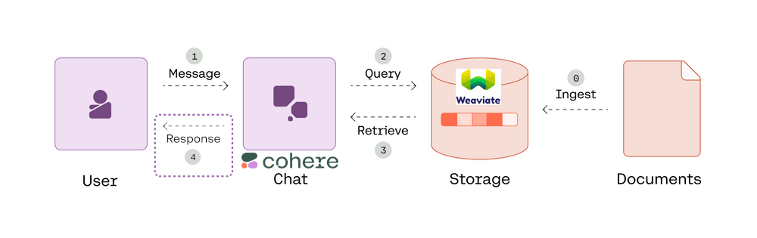
Traditional RAG

Slide 6
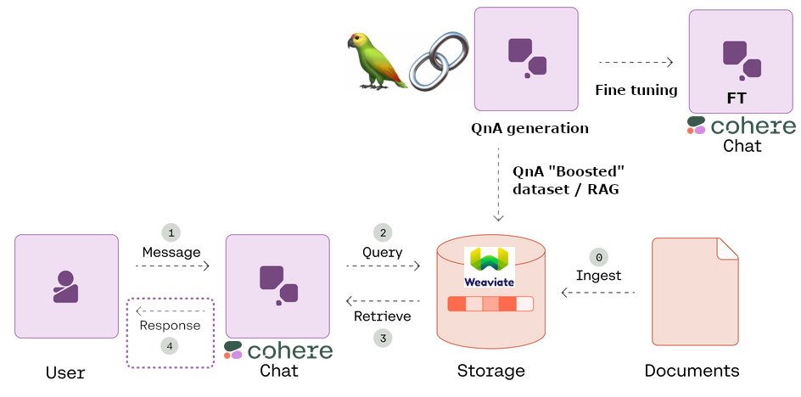
QnA BOOSTED RAG

Slide 7
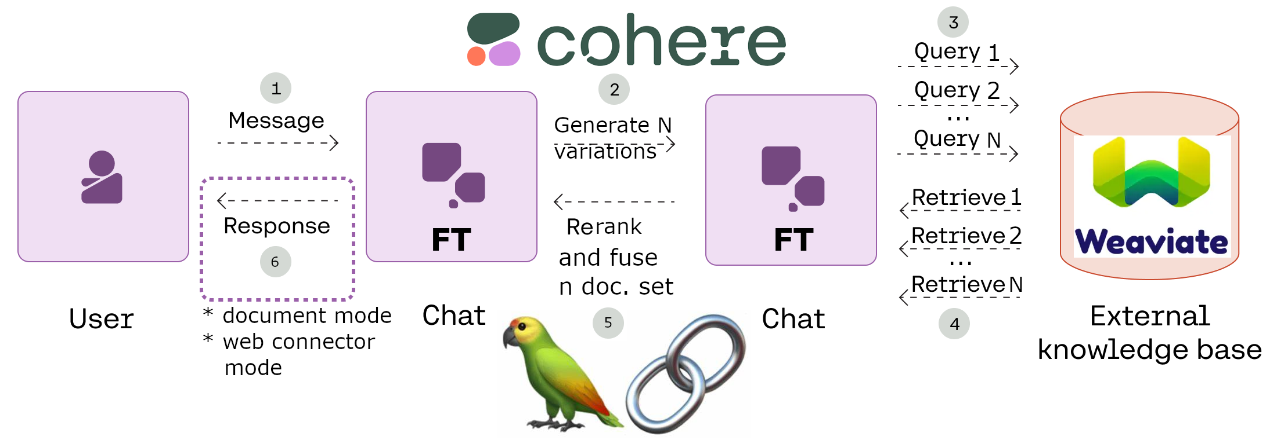
RAG FUSION

Slide 8
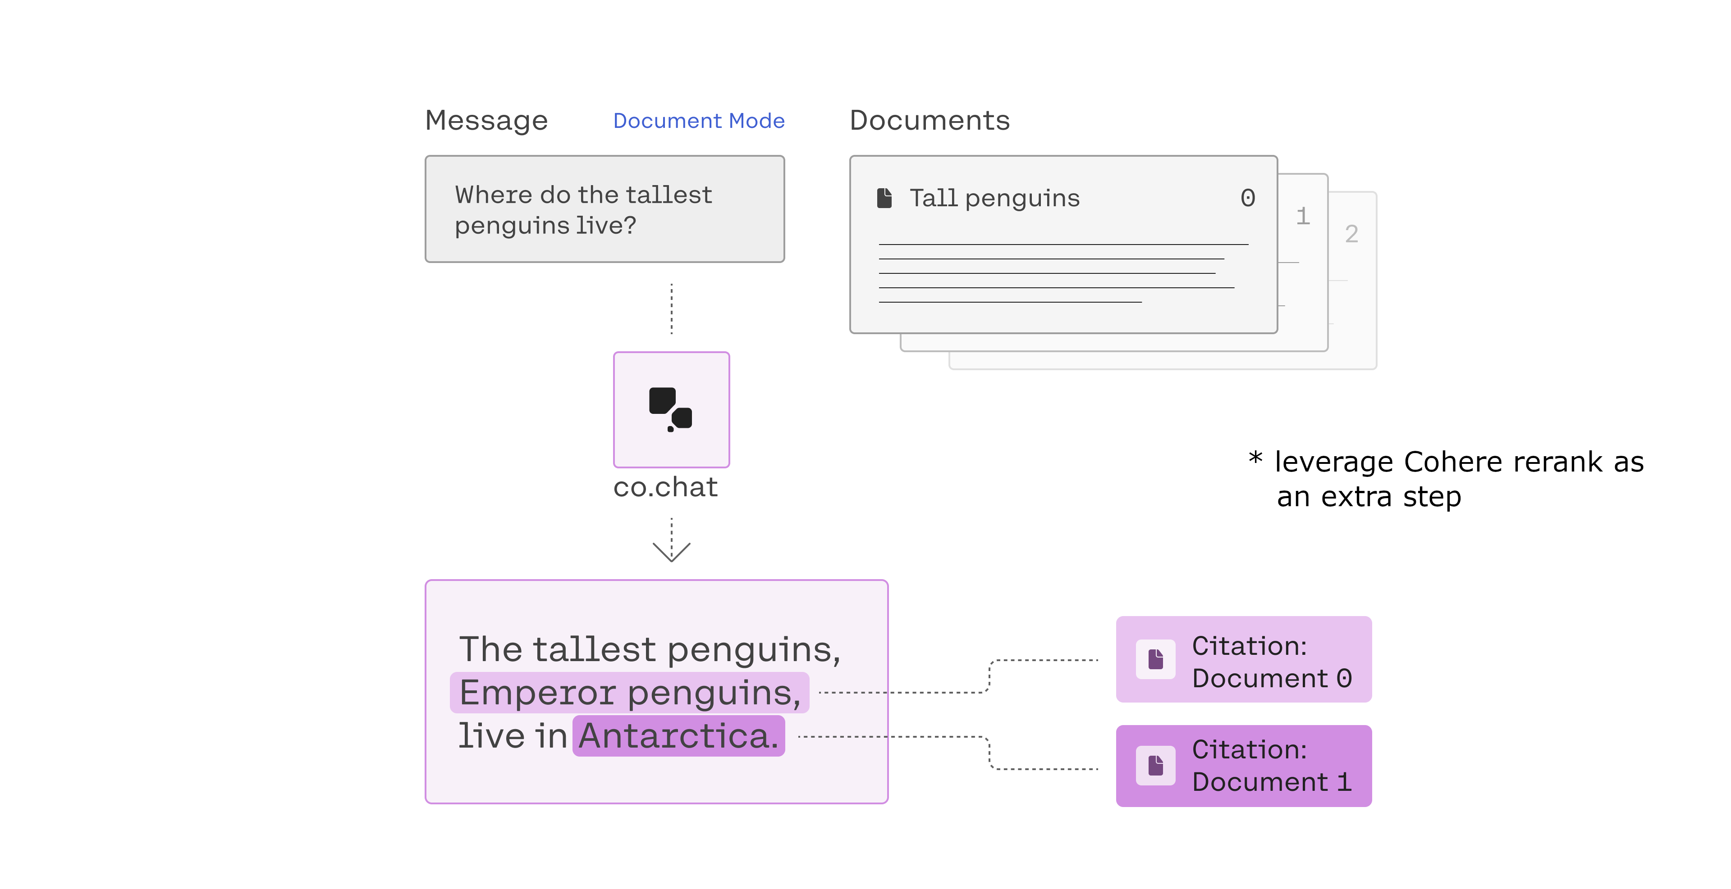
STEP 4 pt1: DOCUMENT MODE

Slide 9
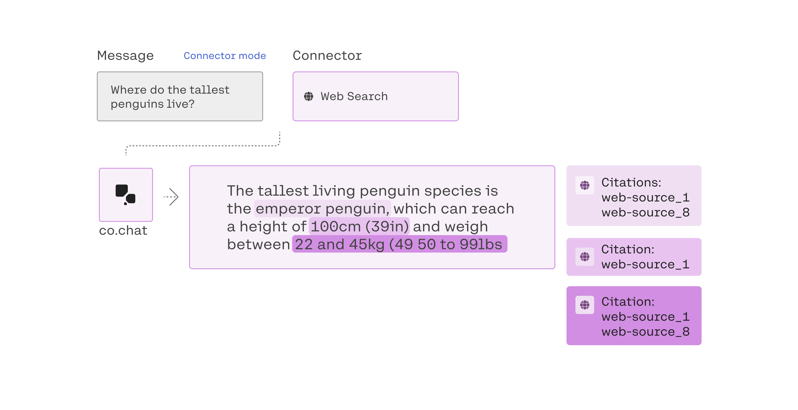
STEP 4 pt2: CONNECTOR MODE

Slide 10
ACCOMPLISMENTS
RAG FUSION
Using LangChain, Weaviate, Cohere
STREAMLIT
Serving platform is Streamlit, highly customized and advanced UI with references
https://github.com/CsabaConsulting/ThruThinkCohereWeaviateChat
Notebooks
https://github.com/CsabaConsulting/Cohere

Slide 11

Accomplishments
Contributed to question_extractor for the QnA generation, and QnA reprocessing for ingestion
Check-pointing to resume generation
Cohere fine tuning format
Rate limiting
https://github.com/CsabaConsulting/question_extractor
QBRAG with the synthetic / augmented data

Slide 12

Co.CHAT
Document mode
Web connector mode
Several advanced capabilities such as built-in conversation management
Rerank as an extra measure when applicable

Slide 13

TO-DO
Features
Measurements
Adding example query phrases for easier testing of domain knowledge
Prompt engineer the variation prompt
Leverage Cohere rerank
Follow up questions with context references throw the chain off
Measure how much the RAG Fusion improves answer quality
Measure the trade-off factoring in extra latency and potential token usage increase which also means cost increase.

Slide 14
Future Plans
Enhancements
Productionize
Decrease runtime by running the variation document retrievals in parallel, this is a Streamlit specific tech challenge with asyncio / await.
Decrease runtime by running the final two co.chat RAG calls in parallel, this is a Streamlit specific tech challenge with asyncio / await.
Make the citation linking nicer and other UI enhancements.
Integrate the agent into ThruThink which uses ASP.NET MVC / C# / Azure technology stack. I'll be able to open up referred help topics using the meta-data.
Add filter against harmful content, for example using Google PaLM2's safety attributes.

Slide 15

Thank you
Csaba Toth
https://csaba.page/
https://www.linkedin.com/in/csabatothdev

